Slide 1
Node.js Web App
Lecturer: Ngo Huy Bien
Software Engineering Department
Faculty of Information Technology
University of Science
Ho Chi Minh City, Vietnam
nhbien@fit.hcmus.edu.vn

Slide 2

Objectives
To create a web application using Node.js.

Slide 3

Contents

Slide 4

References
Jonathan Wexler (2019). Get Programming with Node.js. Manning Publications.
Bruno Joseph D'mello et al. (2017). Web Development with MongoDB and Node. Packt Publishing.

Slide 5
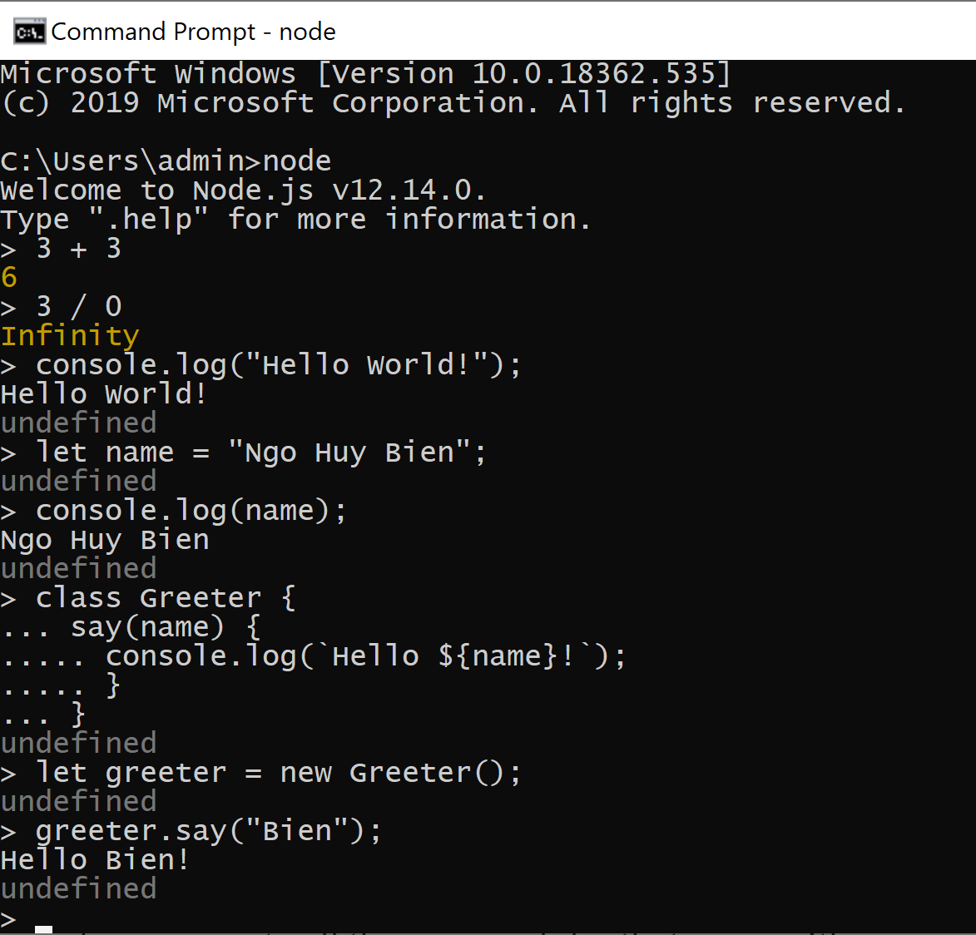
1. Open Node.js REPL
The interactive Node.js shell is the Node.js version of Read-Evaluate-Print Loop (REPL).
This shell is a space in which you can write pure JavaScript and evaluate your code in the terminal window in real time.
Type: node to open the interactive Node.js shell.

Slide 6
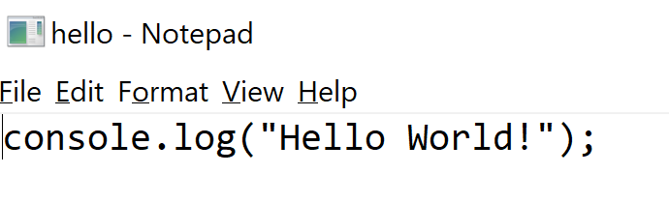
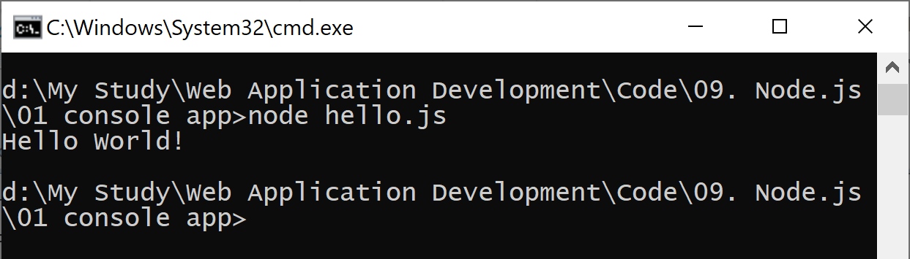
2. Create and Run Hello World
node hello.js

Slide 7


Slide 8
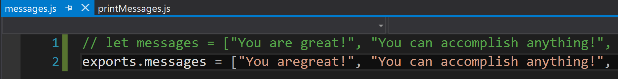
1. Create a Node.js Module [1]
A Node.js application is made up of many JavaScript files.
For your application to stay organized and efficient, these files need to have access to one another’s contents when necessary.
Each JavaScript file or folder containing a code library is called a module.
The exports object is a property of the module object.
module is both the name of the code files in Node.js and one of its global objects.
exports is shorthand for module.exports.

Slide 9
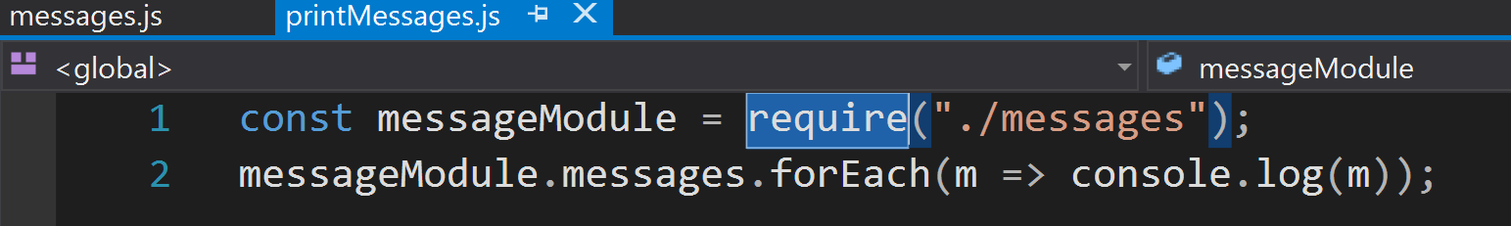
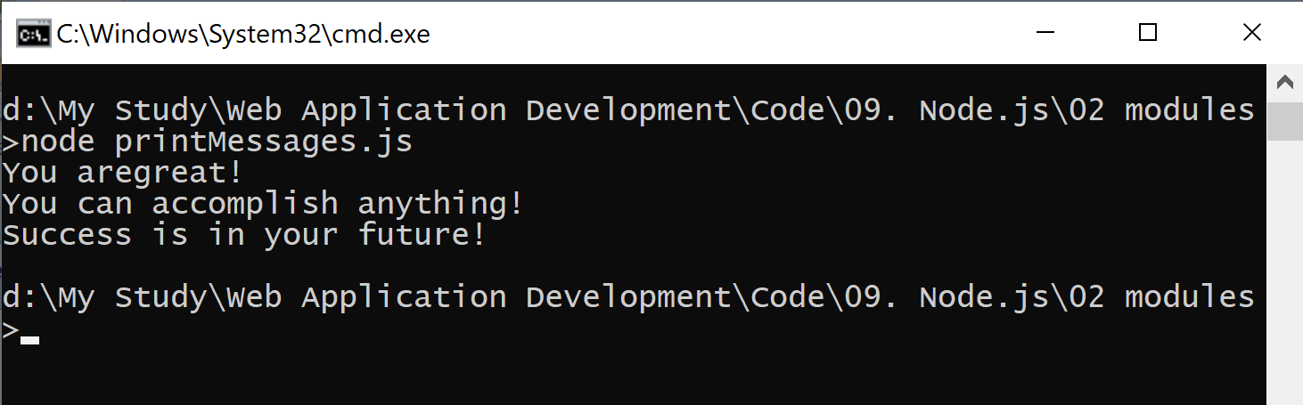
2. Call a Node.js Module
require is another Node.js global object used to locally introduce methods and objects from other modules.

Slide 10

CommonJS
Node.js uses CommonJS, a tool that helps JavaScript run outside a browser by helping define how modules are used.
For module loading, CommonJS specifies the require function.
For exporting modules, CommonJS provides the exports object for each module.
Much of the syntax and structure you use results from CommonJS module designs.
How does CommonJS work?

Slide 11
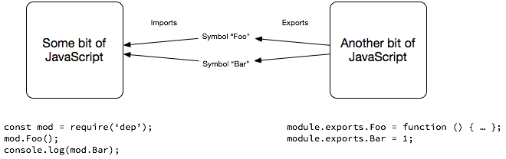
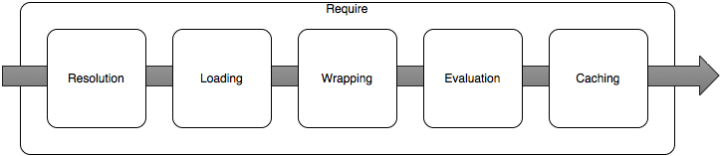
What is a Module?
https://hackernoon.com/node-js-tc-39-and-modules-a1118aecf95e

Slide 13
What is npm?
With your installation of Node.js, you also got npm, a package manager for Node.js.
npm is responsible for managing the external packages (modules that others built and made available online) in your application.
Throughout application development, you use npm to install, remove, and modify these packages.

Slide 14
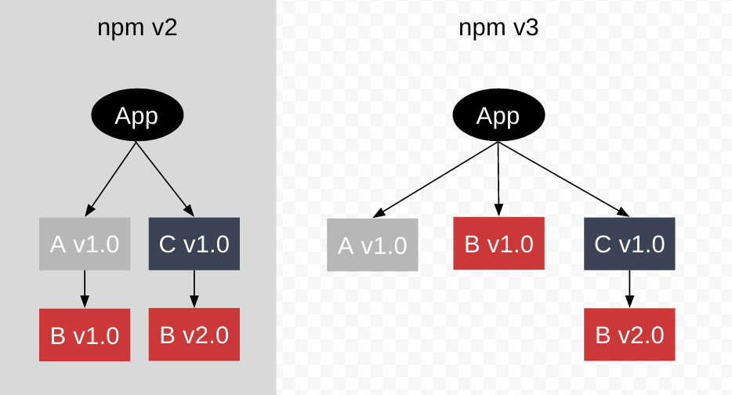
How npm Works
https://npm.github.io/how-npm-works-docs/index.html

Slide 15
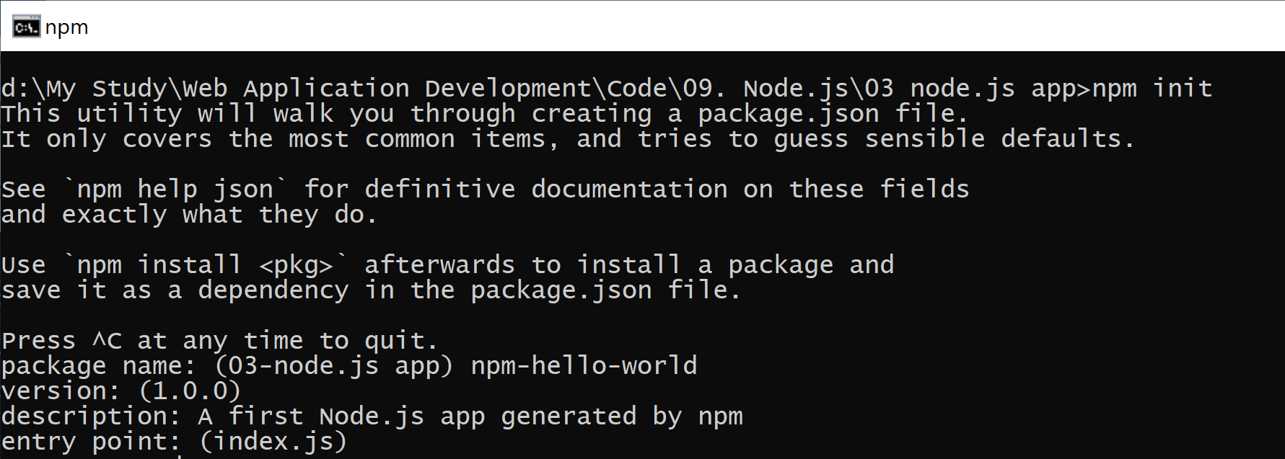
1. Initialize a Node.js Application
npm init

Slide 16
2. Modify package.json
{
"name": "npm-hello-world",
"version": "1.0.0",
"description": "A first Node.js app generated by npm",
"main": "index.js",
"scripts": {
"test": "echo \"Error: no test specified\" && exit 1"
},
"author": "Ngo Huy Bien",
"license": "ISC"
}

Slide 17
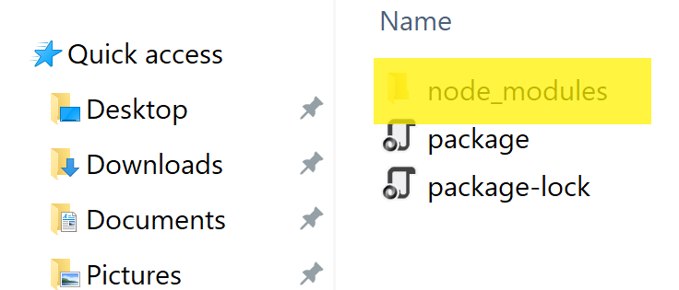
3. Install a Module
npm install cities --save
{
"name": "npm-hello-world",
"version": "1.0.0",
"description": "A first Node.js app generated by npm",
"main": "index.js",
"scripts": {
"test": "echo \"Error: no test specified\" && exit 1"
},
"author": "Ngo Huy Bien",
"license": "ISC",
"dependencies": {
"cities": "^2.0.0"
}
}

Slide 18
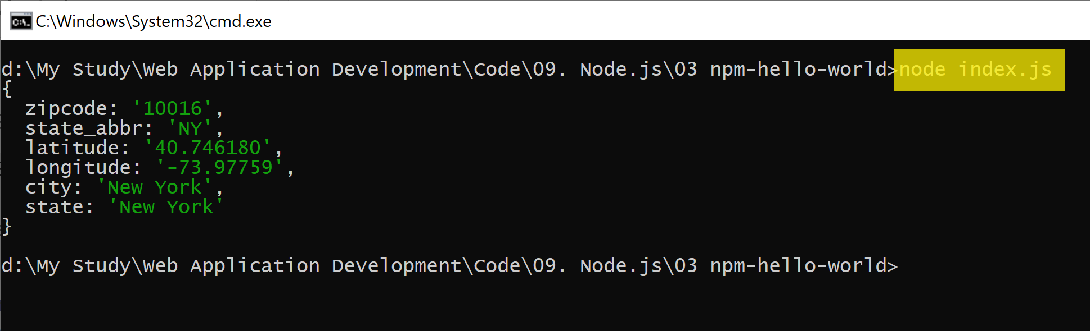
4. Run the Application (index.js)
node index.js
const cities = require("cities");
var myCity = cities.zip_lookup("10016");
console.log(myCity);

Slide 20
1. Create a Web Application
npm init -y
sudo nano index.js
const port = 3000,
http = require("http"),
httpStatus = require("http-status-codes"),
app = http.createServer((request, response) => {
console.log("Received an incoming request!");
response.writeHead(httpStatus.OK, {
"Content-Type": "text/html"
});
let responseMessage = "<h1>Hello World!</h1>";
response.write(responseMessage);
response.end();
console.log(`Sent a response : ${responseMessage}`);
});
app.listen(port);
console.log(`The server has started and is listening on port number: ${port}`);

Slide 21
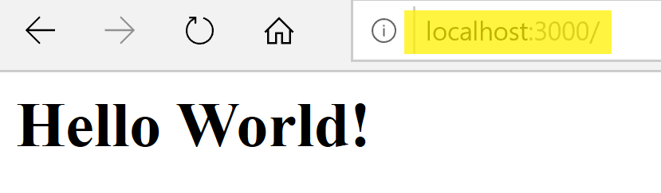
2. Run a Web Application
npm install http-status-codes --save
node index.js

Slide 22
3. Add npm start
sudo nano package.json
npm start
{
"name": "hello_world",
...
"main": "index.js",
"scripts": {
"start": "node index.js",
"test": "echo \"Error: no test specified\" && exit 1"
},
...
"dependencies": {
"http-status-codes": "^2.1.4"
}
}

Slide 23
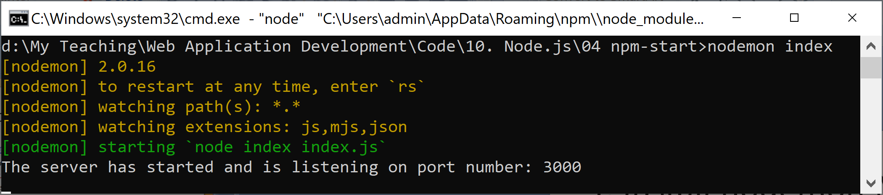
4. Install nodemon Module
https://www.npmjs.com/package/nodemon
nodemon is a tool that helps develop Node.js based applications by automatically restarting the node application when file changes in the directory are detected.
npm install -g nodemon
nodemon index

Slide 25
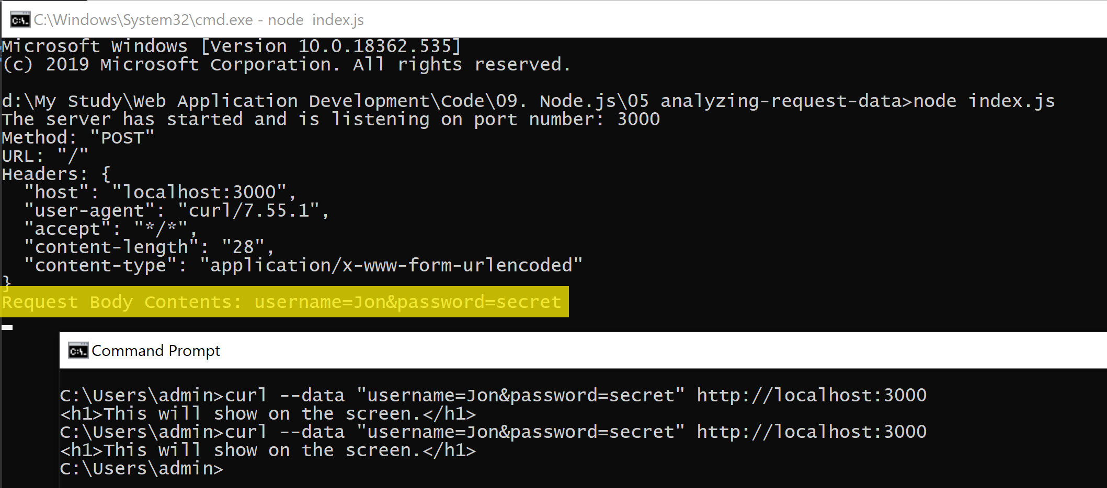
1. Retrieve Request Data
curl --data "username=Jon&password=secret“ http://localhost:3000
See the “05 analyzing-request-data” folder for detail.

Slide 26
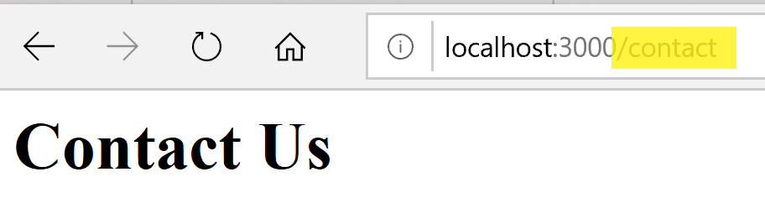
2. Add Routes
See the “06 adding-routes” folder for detail.
const routeResponseMap = {
"/info": "<h1>Info Page</h1>",
"/contact": "<h1>Contact Us</h1>",
"/about": "<h1>Learn More About Us.</h1>",
"/hello": "<h1>Say hello by emailing us here</h1>",
"/error": "<h1>Sorry the page you are looking for is not here.</h1>"
};
const port = 3000,
http = require("http"),
httpStatus = require("http-status-codes"),
app = http.createServer((req, res) => {
res.writeHead(200, {
"Content-Type": "text/html"
});
if (routeResponseMap[req.url]) {
res.end(routeResponseMap[req.url]);
} else {
res.end("<h1>Welcome!</h1>");
}
});

Slide 27
3. Serve Static Files
npm install fs –save
See the “07 serving-static-files” folder for detail.
const routeMap = {
"/": "views/index.html"
};
http
.createServer((req, res) => {
res.writeHead(httpStatus.OK, {
"Content-Type": "text/html"
});
if (routeMap[req.url]) {
fs.readFile(routeMap[req.url], (error, data) => {
if (error) {
res.writeHead(httpStatus.NOT_FOUND);
res.write("<h1>FILE NOT FOUND</h1>");
} else {
res.writeHead(httpStatus.OK, {
"Content-Type": "text/html"
});
res.write(data);
}
res.end();
});
} else {
res.end("<h1>Sorry, not found.</h1>");
}
})
.listen(port);

Slide 28
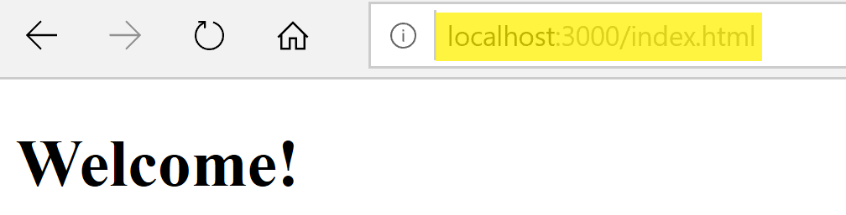
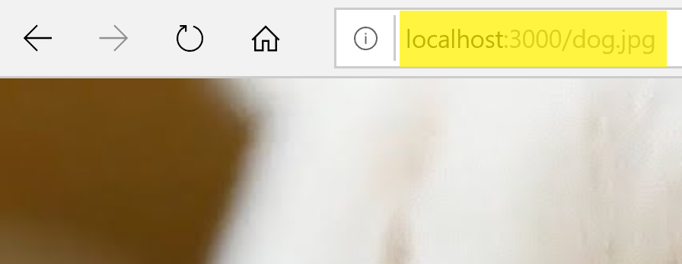
4. Serve Assets
npm install fs –save
See the “08 serving-assets” folder for detail.
http
.createServer((req, res) => {
let url = req.url;
if (url.indexOf(".html") !== -1) {
res.writeHead(httpStatus.OK, {
"Content-Type": "text/html"
});
customReadFile(`./views${url}`, res);
} else if (url.indexOf(".js") !== -1) {
res.writeHead(httpStatus.OK, {
"Content-Type": "text/javascript"
});
customReadFile(`./public/js${url}`, res);
} else if (url.indexOf(".css") !== -1) {
res.writeHead(httpStatus.OK, {
"Content-Type": "text/css"
});
customReadFile(`./public/css${url}`, res);
} else if (url.indexOf(".png") !== -1) {
res.writeHead(httpStatus.OK, {
"Content-Type": "image/png"
});
customReadFile(`./public/images${url}`, res);
} else if (url.indexOf(".jpg") !== -1) {
res.writeHead(httpStatus.OK, {
"Content-Type": "image/jpg"
});
customReadFile(`./public/images${url}`, res);
} else {
sendErrorResponse(res);
}
})
.listen(3000);

Slide 30
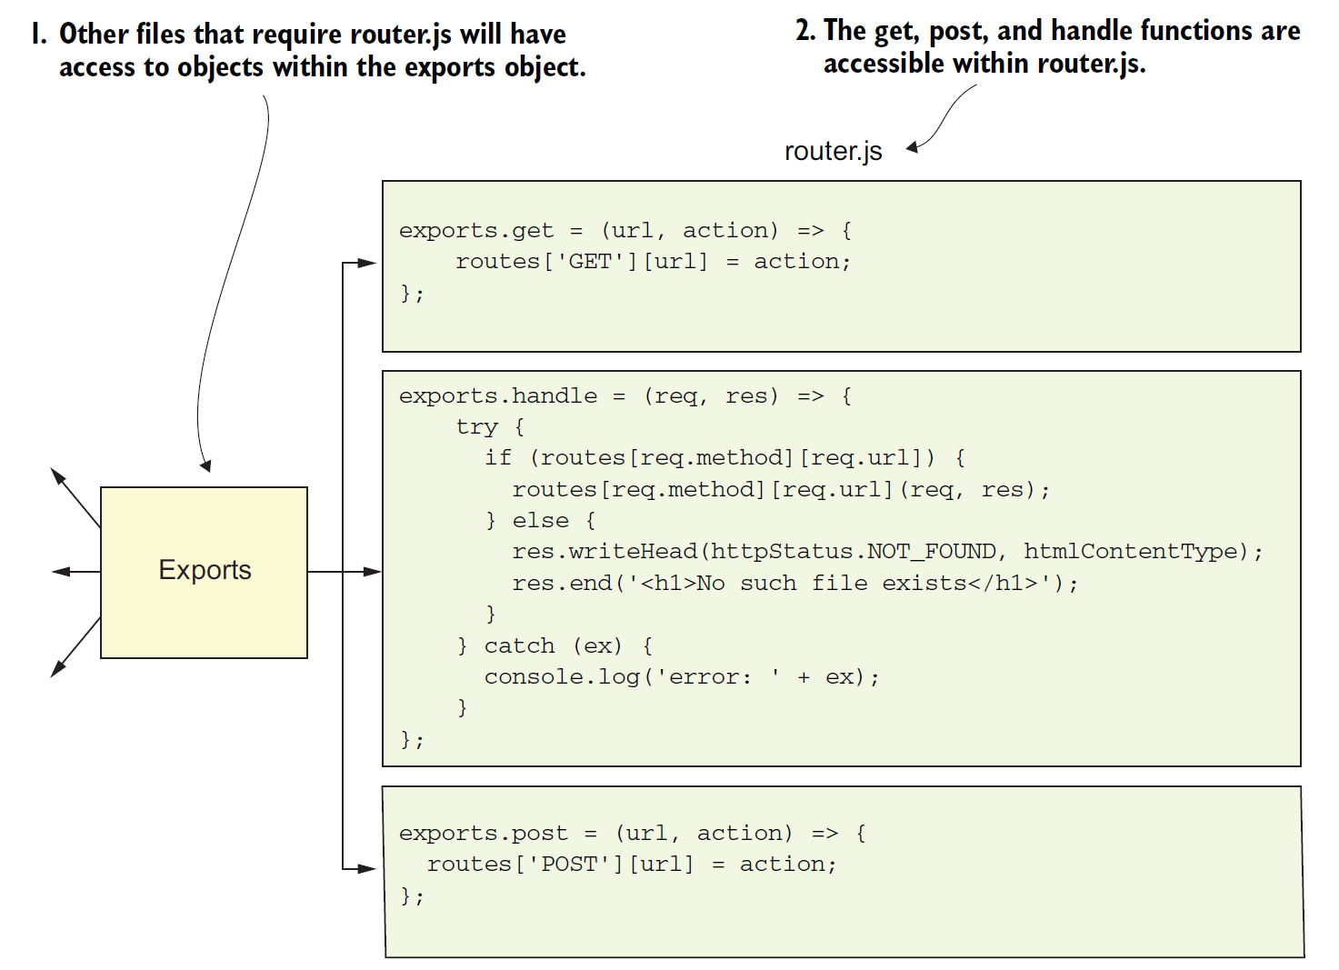
1. Create Modular Application
See the “09 modular-application” folder for detail.

Slide 31
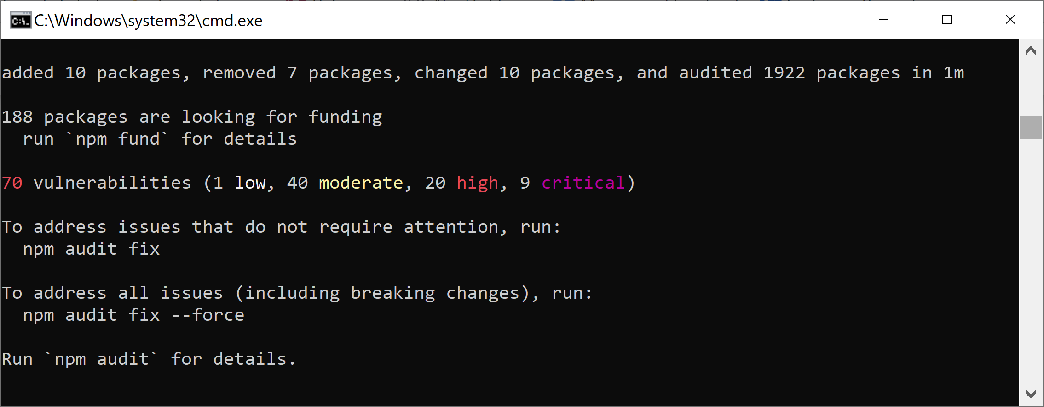
2. Check Vulnerabilities
npm update

Slide 32
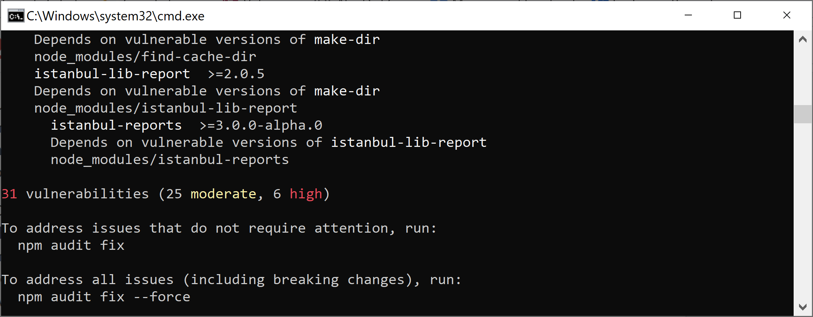
3. Fix Vulnerabilities
npm audit fix
npm audit fix --force

Slide 33
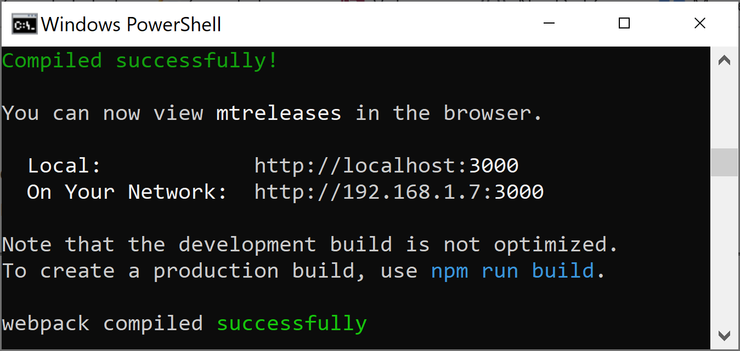
4. Check Result
Delete node_modules folder.
npm install
npm start

Slide 35
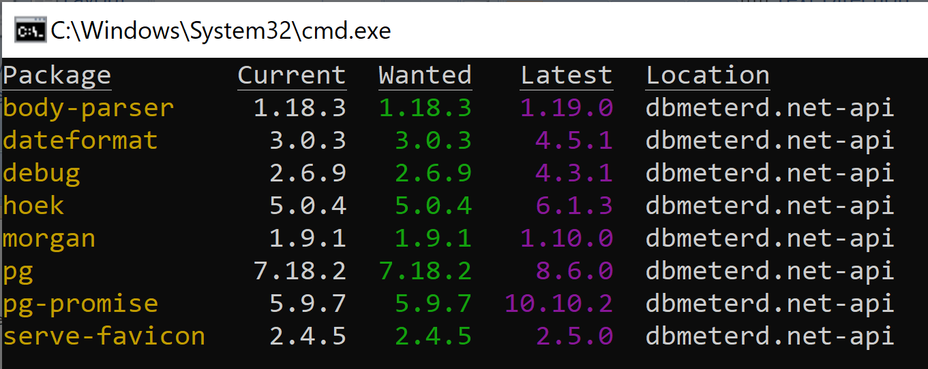
1. Check Outdated Packages
To discover new releases of the packages, you run
npm outdated

Slide 36
2. Fix Outdated Packages
npm i --save-dev body-parser@1.19.0
npm i --save-dev dateformat@4.5.1
npm i --save-dev debug@4.3.1
...
Important note: Repeat until all the packages are fixed.

Slide 37
devDependencies
https://github.com/npm/npm/blob/2e3776bf5676bc24fec6239a3420f377fe98acde/doc/files/package.json.md#devdependencies
f someone is planning on downloading and using your module in their program, then they probably don't want or need to download and build the external test or documentation framework that you use.
In this case, it's best to list these additional items in a devDependencies hash.

Slide 38
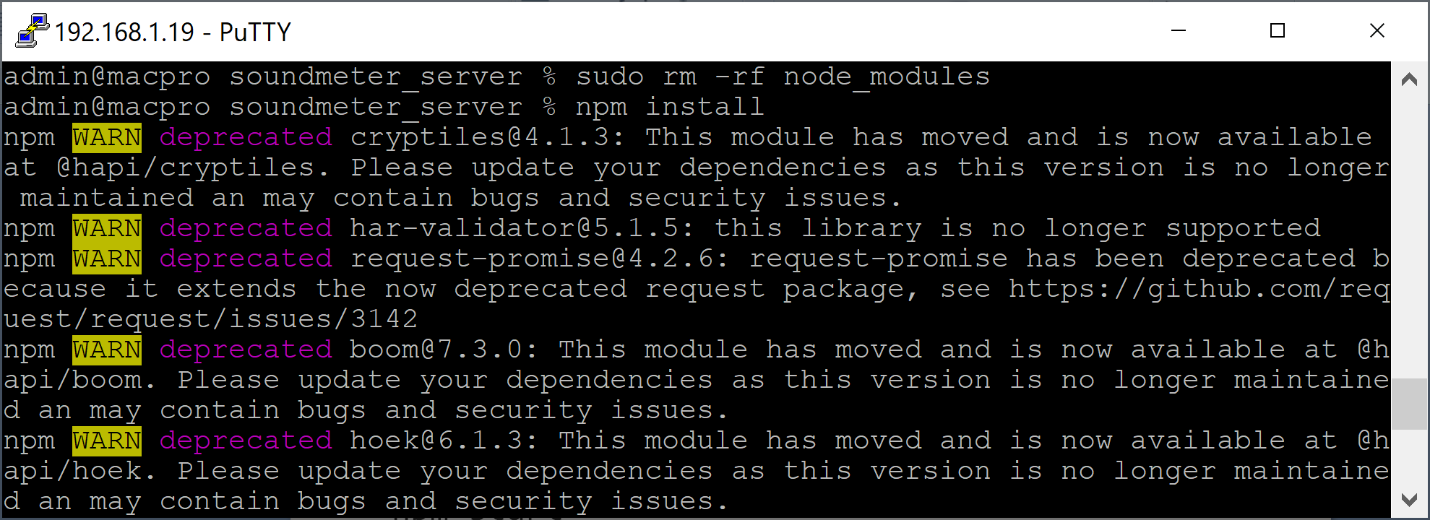
3. Check Deprecated Packages
To discover deprecated packages, run
sudo rm -rf node_modules
npm install

Slide 39
4. Fix a Deprecated Package
Check
https://www.npmjs.com/package/@hapi/cryptiles
for the latest version of @hapi/cryptiles
Open packages.json, replace "cryptiles" by "@hapi/cryptiles", update the version, then run
sudo rm -rf node_modules
npm install

Slide 41
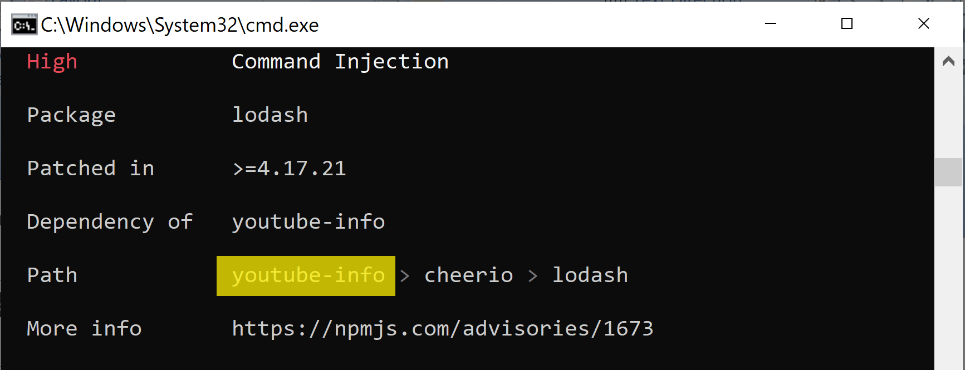
1. Manually Fix Vulnerabilities
npm audit

Slide 42
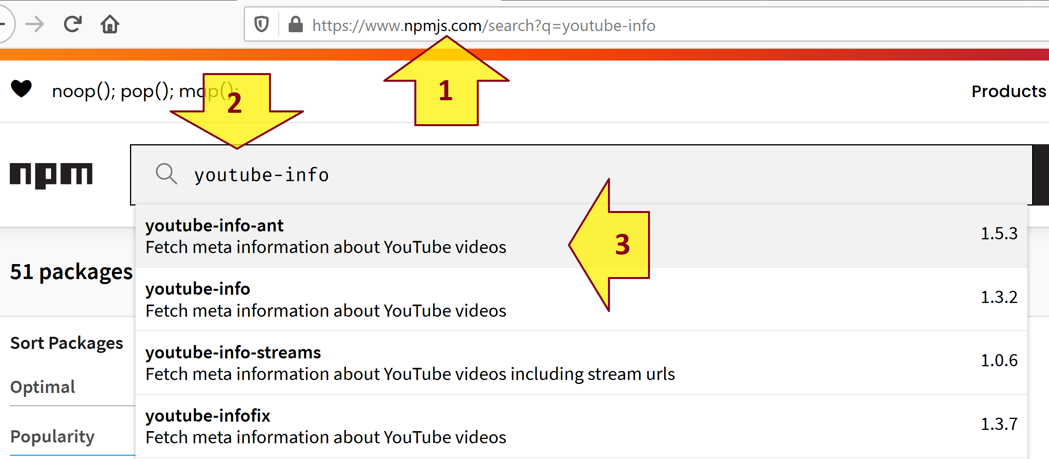
2. Find the Latest Version or an Alternative Package
https://www.npmjs.com/search?q=youtube-info

Slide 43
3. Install the Latest Version or an Alternative Package
npm uninstall youtube-info
npm i youtube-info-ant

Slide 44
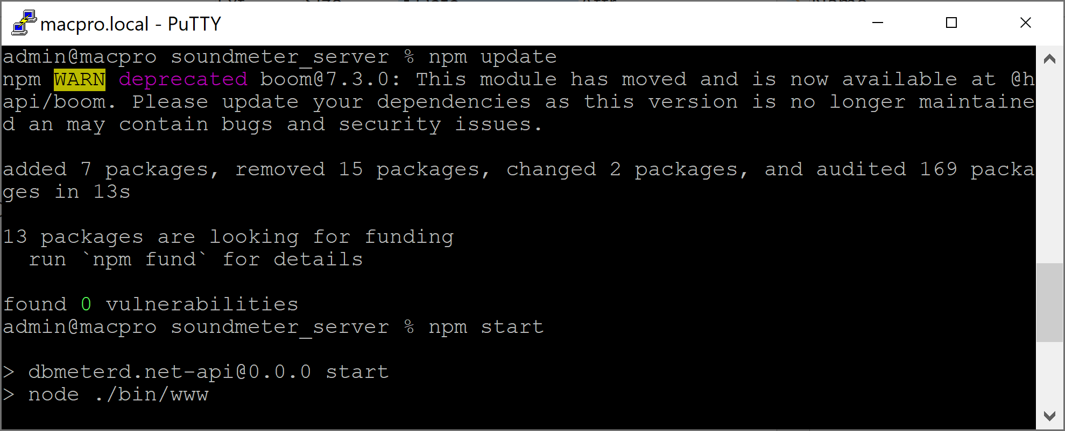
4. Run an Application
npm update
npm start

Slide 46
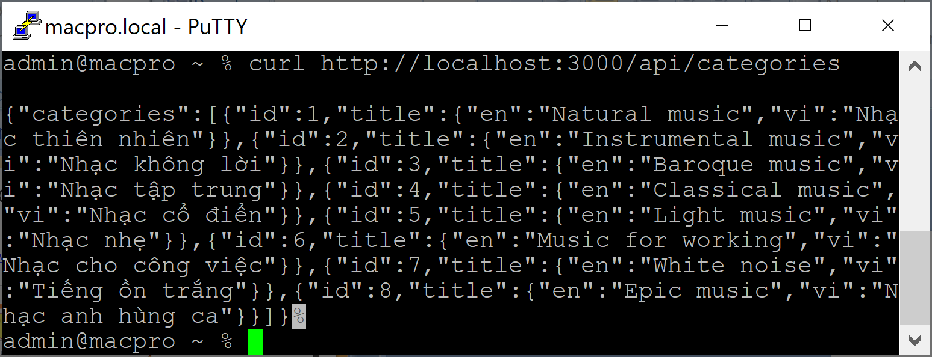
1. Test a GET API
curl http://macpro:3000/api/categories

Slide 47
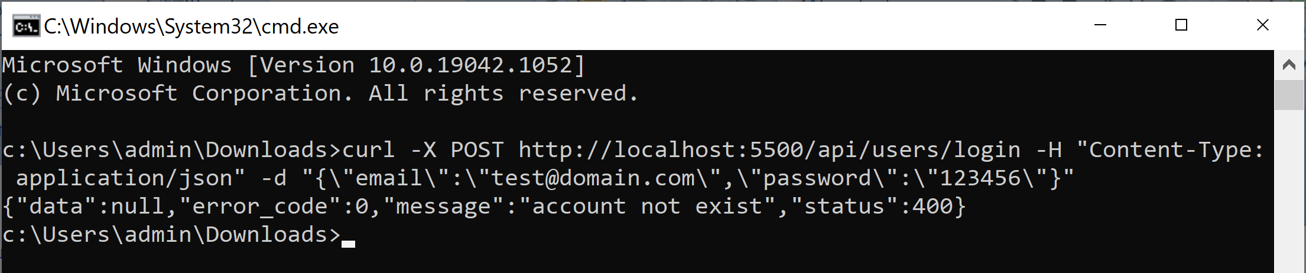
2. Test a POST API
curl -X POST http://localhost:5500/api/users/login -H "Content-Type: application/json" -d "{\"email\":\"test@domain.com\",\"password\":\"123456\"}"

Slide 48
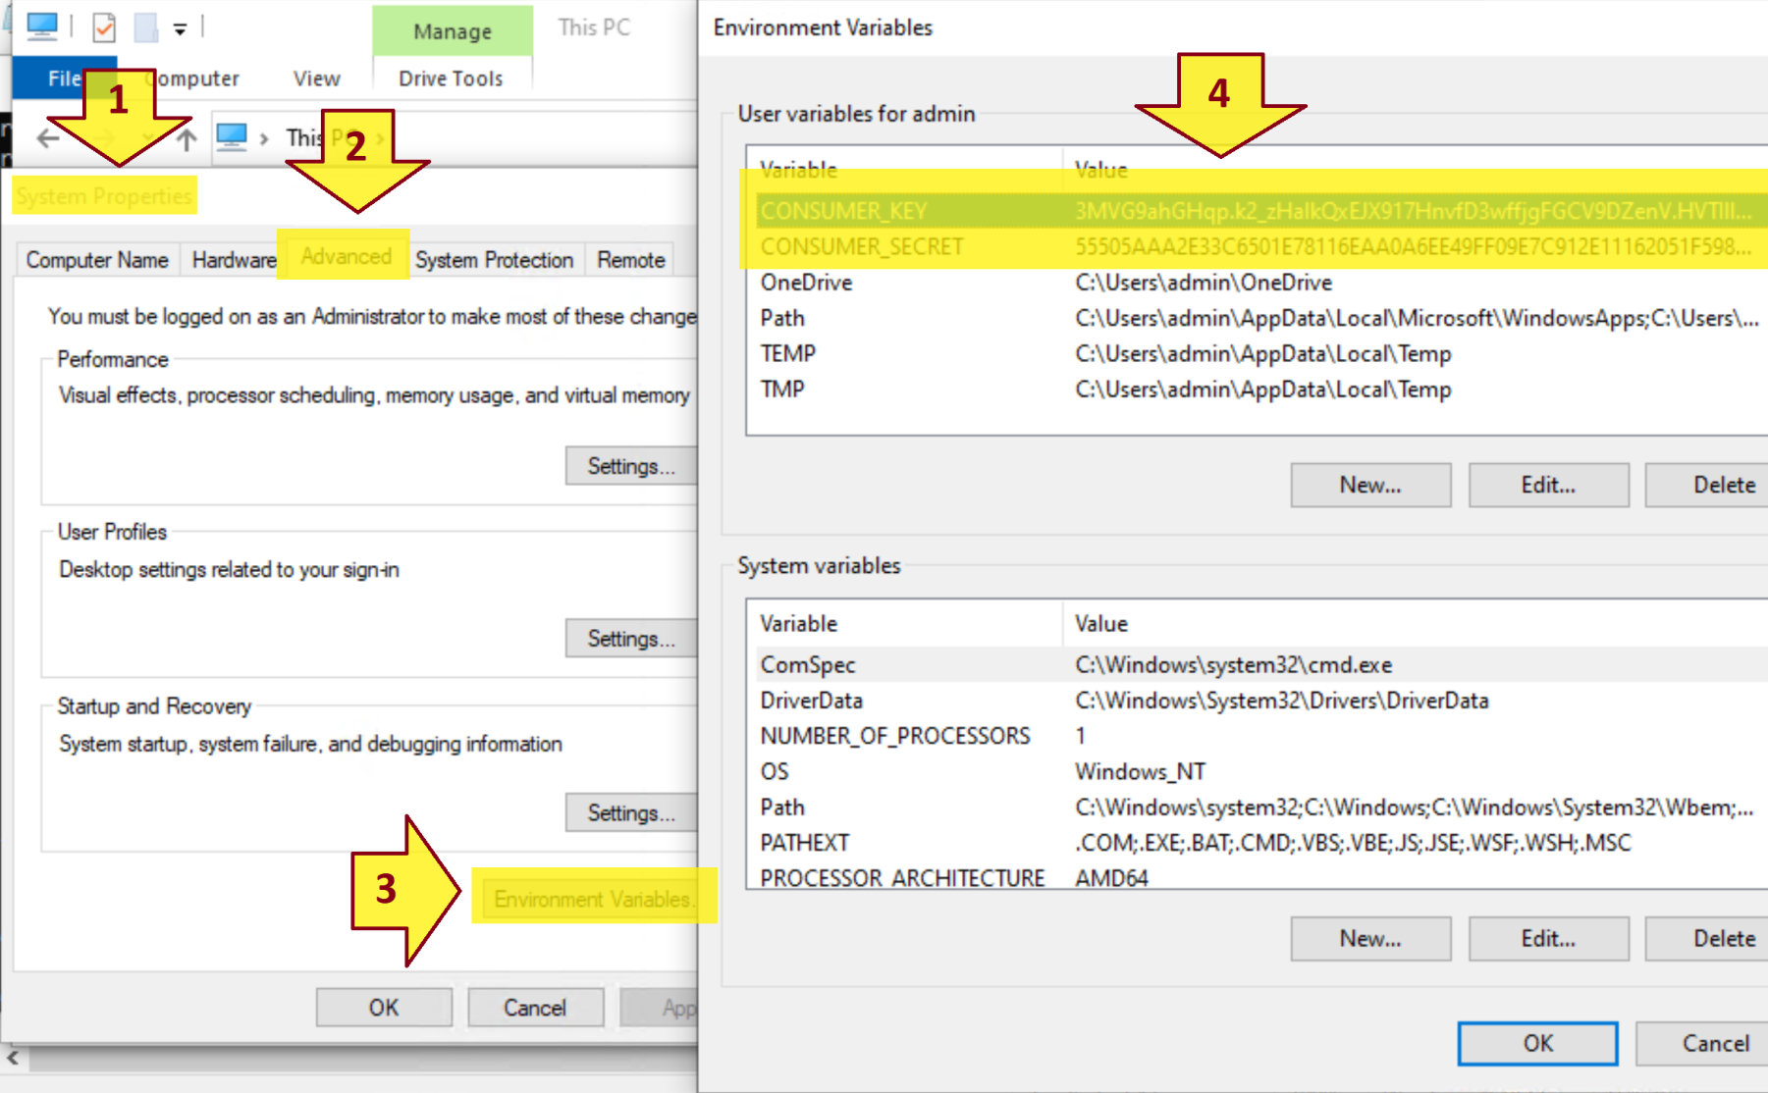
3. Create Windows Environment Variables

Slide 50
What is Node.js? [2]
It can be considered as a runtime environment for JavaScript built on top of Google's V8 engine.
It provides us with a context where we can write JavaScript code on any platform where Node.js can be installed.
JavaScript is an interpreted language and it will not be as efficient as a compiled language, as each line of code gets interpreted one by one while the code gets executed.
The V8 engine brings in an efficient model, where the JavaScript code is first interpreted and then compiled into machine-level code.

Slide 51
Why Node.js?
Typical PHP, ASP.NET, Ruby, or Java-based servers follow a model where each client request results in the instantiation of a new thread or even a process.
When it comes to Node.js, requests are run on the same thread with shared resources.
It tries to do asynchronous processing on a single thread to provide more performance and scalability for applications that are supposed to handle too much web traffic.
Imagine web applications that handle millions of concurrent requests; if the server makes a new thread for handling each request that comes in, it will consume a lot of resources and we will end up trying to add more and more servers to increase the scalability of the application.

Slide 52
Notes
The point that Node.js is single-threaded doesn't mean that it doesn't use threads internally.
It is just that the developer and the execution context that the code has exposure to have no control over the threading model internally used by Node.js.
http://www.cs.ucsb.edu/~rich/class/cs170/notes/IntroThreads/

Slide 53
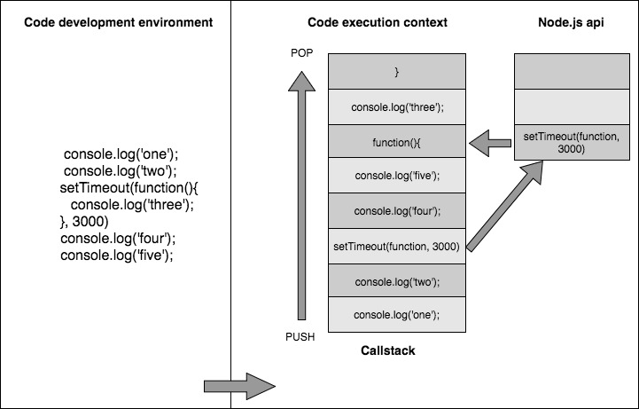
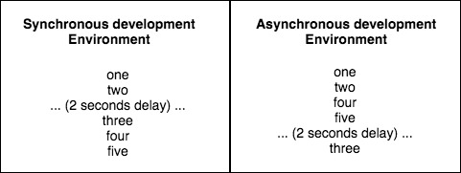
Non-blocking Asynchronous Execution

Slide 54
Sharing and Reusing JavaScript
While you develop web applications, you will always end up doing the validations for your UI, both at the client and server sides, as the client-side validations are required for better UI experience and server-side validations are needed for better security of the app.
Think about two different languages in action: you will have the same logic implemented in both the server and client sides.
With Node.js, you can think of sharing the common function between server and client, reducing the code duplication to a large extent.
Think about the templates, models, and controller subsets being shared on both client and server.
We are solving a higher scenario of code redundancy.

Slide 55
A Lot of Libraries
Grunt.js is a great example of a Node-powered command-line tool that many web developers use daily to automate tasks such as build processes, compiling CoffeeScript, launching Node.js servers, running tests.
Johnny-Five and Cylon.js are two popular Node.js libraries that exist to provide a framework to work with robotics.
Node.js has a couple of frameworks built for real-time web applications which are hugely popular: Socket.io and Sock.JS.
With Node.js's networking modules, you can create server and client applications that accept network connections and communicate via streams and pipes.
Node.js packages for Arduino, Raspberry Pi (IoT)

Slide 56
Node Module System Review
You write a code fulfilling a single concern, and export this code using module.exports (or simply exports) as a module that serves that single purpose.
Whenever you need to use that code elsewhere in your code base, you will require that module.
// ** file: dowork.js
module.exports = {
doWork: function(param1, param2) {
return param1 + param2;
}
}
// ** file: testing.js
var worker = require('./dowork'); // note: no .js in the file
var something = 1;
var somethingElse = 2;
var newVal = worker.doWork(something, somethingElse);
console.log(newVal);
// => 3

Slide 57
Node Project Review
Node projects, typically, include a special file called package.json that contains information about the project as well as a list of all npm packages that the project depends on.
A developer with a copy of your local code can simply execute npm install to have every dependency downloaded and installed locally using this file.
$ npm init
$ npm install express --save
$ npm install grunt --save-dev
$ cat package.json
{
"name": "chapter3",
"version": "0.0.0",
"description": "",
"main": "index.js",
"scripts": {
"test": "echo \"Error: no test specified\" && exit 1"
},
"author": "",
"license": "ISC",
"dependencies": {
"express": "^3.5.1"
},
"devDependencies": {
"grunt": "^0.4.4"
}
}

Slide 58
When to Use Node.js
Node.js is well suited for applications that are expected to handle a huge amount of concurrent connections.
It is most suited for applications where each incoming request requires very few CPU cycles.
Node.js is well suited for real-time web applications, such as chat rooms, collaboration tools, online games.
If you intend to do computation-intensive tasks upon request, it will end up blocking the event loop, thereby impacting other requests concurrently processed by the web server.

Slide 59
JavaScript Object Notation
JSON is a text format that facilitates structured data interchange between all programming languages.
{
"title": "This is the title",
"description": "Here is where the description would be",
"page-count": 150,
"authors": [
{ "name": "John Smith" },
{ "name": "Jane Doe" },
{ "name": "Andrea Johnson" }
],
"id": "1234-567-89012345"
}

Slide 61
Vite
https://vite.dev/guide/why.html
Before ES modules were available in browsers, developers had no native mechanism for authoring JavaScript in a modularized fashion. This is why we are all familiar with the concept of "bundling": using tools that crawl, process and concatenate our source modules into files that can run in the browser.
However, as we build more and more ambitious applications, the amount of JavaScript we are dealing with is also increasing dramatically. It is not uncommon for large scale projects to contain thousands of modules. We are starting to hit a performance bottleneck for JavaScript based tooling: it can often take an unreasonably long wait (sometimes up to minutes!) to spin up a dev server, and even with Hot Module Replacement (HMR), file edits can take a couple of seconds to be reflected in the browser. The slow feedback loop can greatly affect developers' productivity and happiness.
Vite aims to address these issues by leveraging new advancements in the ecosystem: the availability of native ES modules in the browser, and the rise of JavaScript tools written in compile-to-native languages.

Slide 62
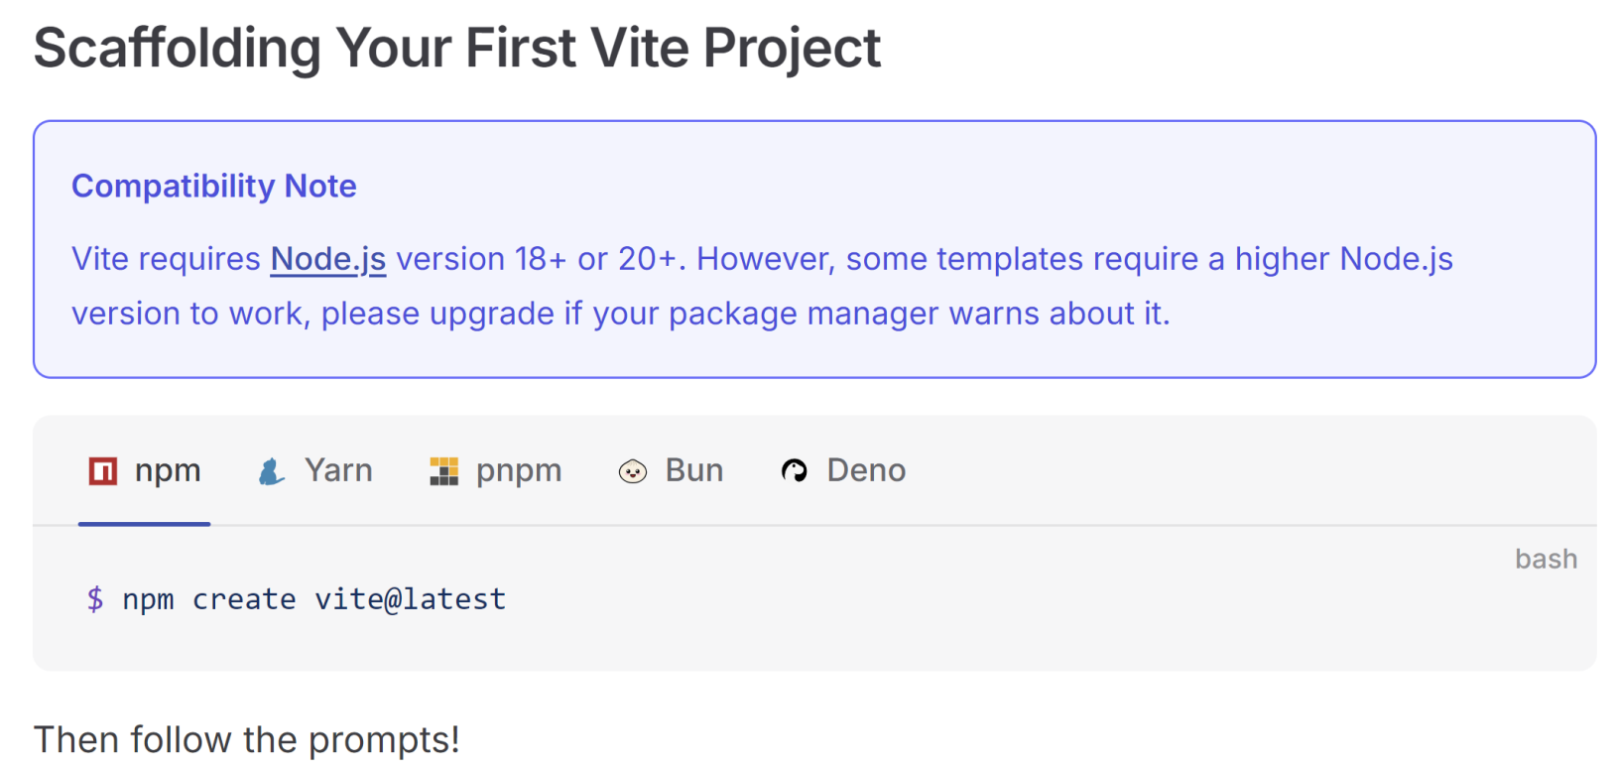
1. Scaffold New Vite Project
https://vite.dev/guide/

Slide 63
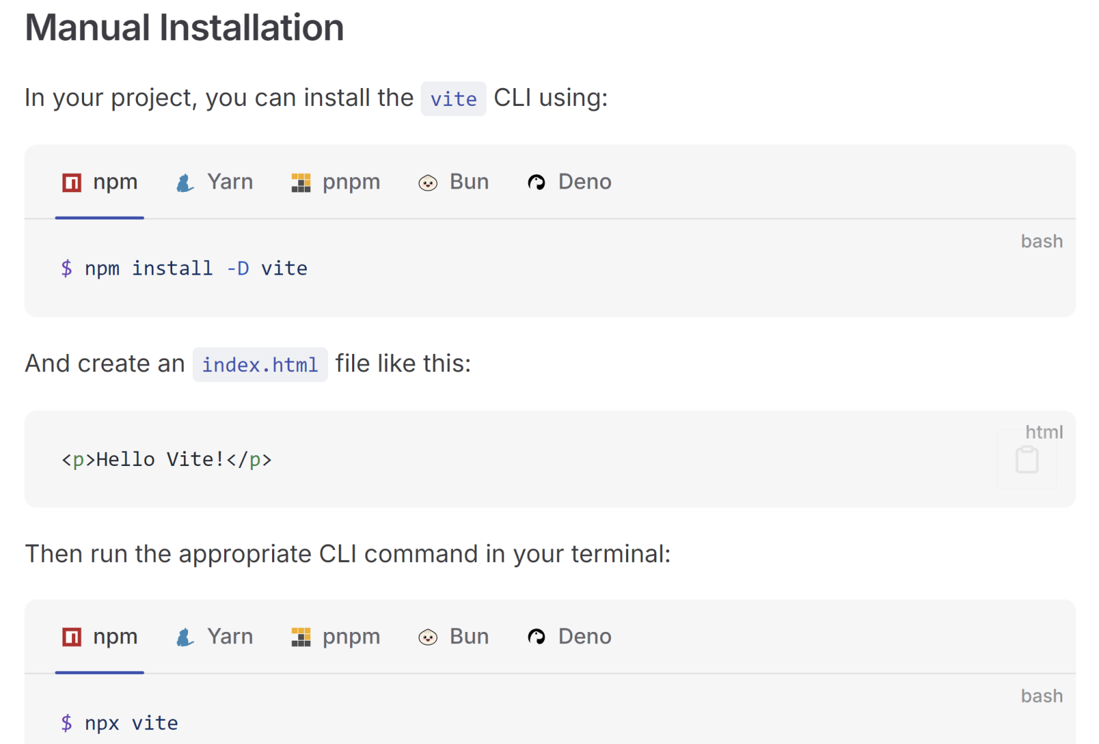
2. Add Vite to Existing Project

Slide 64
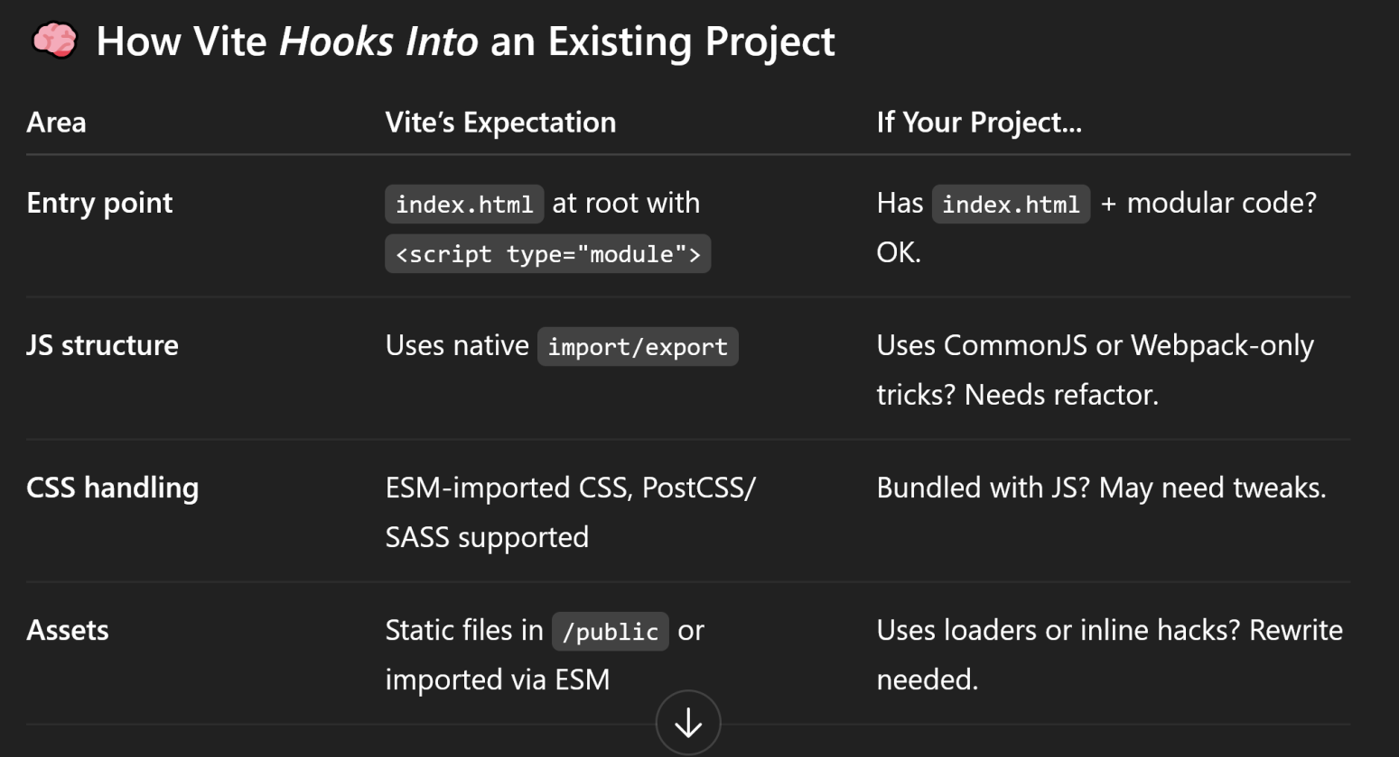
How Vite Hooks Into an Existing Project
If your goal is speed and you can afford a bit of cleanup, Vite is worth the switch.
But don't force it on a messy legacy codebase. That will hurt more than it helps.

Slide 65

Thank You & See You Again

